Slide 1



Slide 2
Autonomous System

Slide 3
RULES
  No side talks
  Phones are in silent mode
  Questions after each slide
  Take permission before leaving
  There will be a break during the session if you want to eat or drink
  Make sure to take notes about what is discussed

Slide 4
Session 3
“Introduction to perception for autonomous vehicles”

Slide 5

About the instructor
ٍHR member 2021
ٍSuspension and steering member 2021
Participated in EVER Egypt Rally competition 2021
Team Manager 2022
Autonomous Subteam head 2023

Slide 6
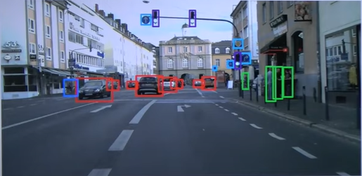
What are Information needed?
Location of pedestrians standing on the street
Vehicles around such as cars and trucks
Understanding traffic signs to know where we go and what we should do
This is useful determining the behavior or planning of the driver’s motion also the control approach

Slide 7
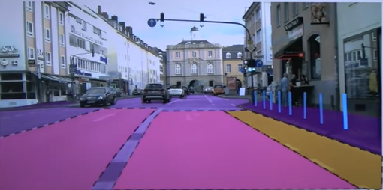
what are Information needed?
Detect drivable space
Detect the position of curbs
know where are lanes and where to move

Slide 8
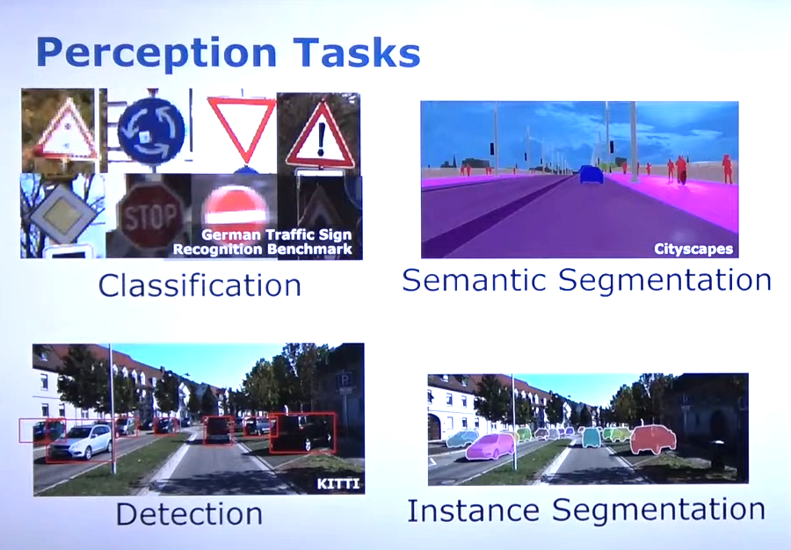
Perception tasks

Slide 9
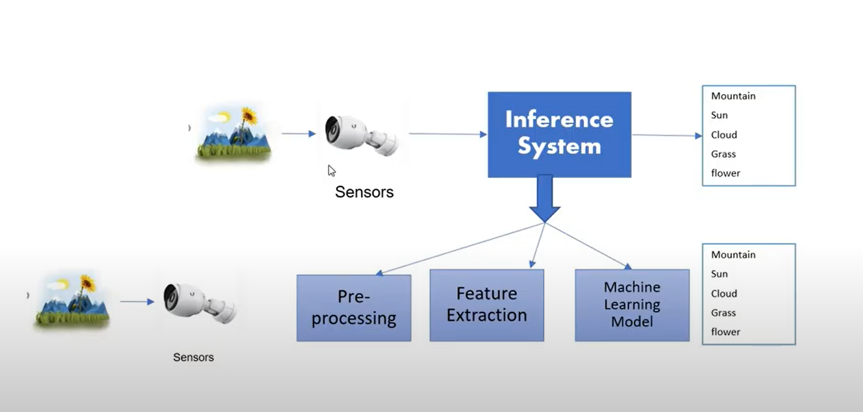
How does computer see?

Slide 10
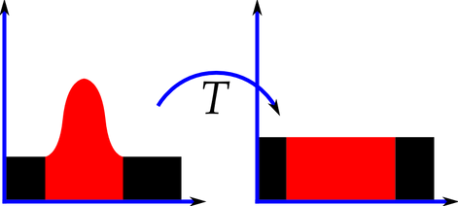
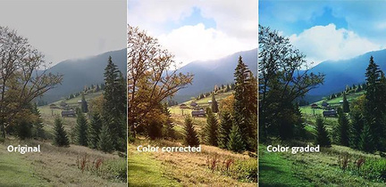
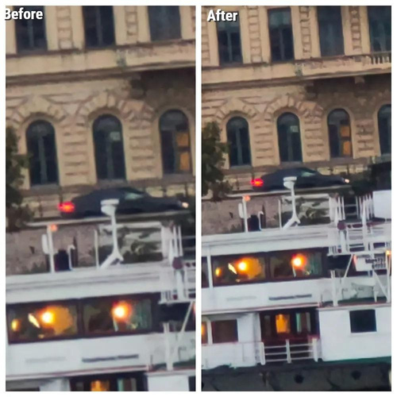
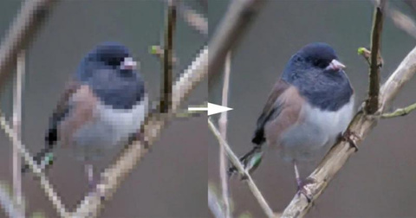

Computer vision pipeline
Preprocessor
Image preprocessing is a crucial step in computer vision and image processing tasks
Histogram
equalization
Color
correction
Noise
removal
Photo
echancement

Slide 11
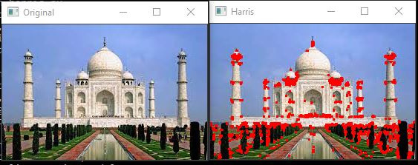
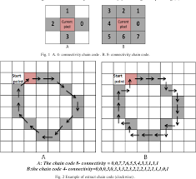
Computer vision pipeline
Feature extraction
Process of extracting important information or patterns from data, reducing dimensionality for analysis or modeling.
Feature
detection
Feature
description

Slide 12
Feature detection
Point of interest in an image that has the following properties:
Identifiable
Repeatablility
Quantity
Locality

Slide 13
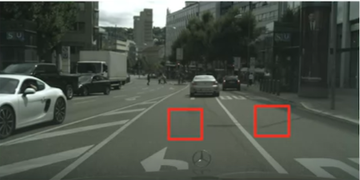
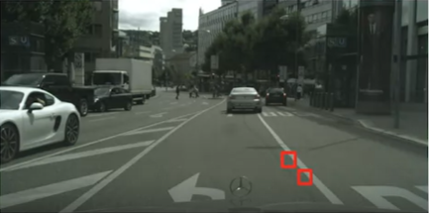
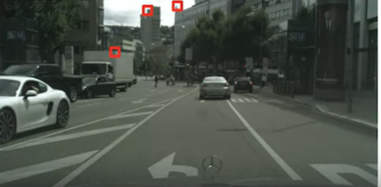
Feature detection

Slide 14
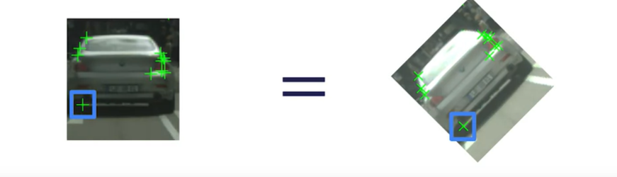
Feature descriptors
Defining a feature points by its coordinates in image frame it has a summary of each information about the feature
Feature descriptors has some characteristics: repeatability
Scale
Translation
Rotation
Illumination

Slide 15
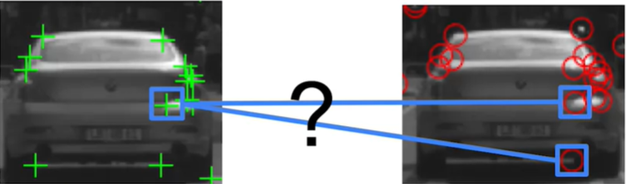
Feature Maching

Slide 16
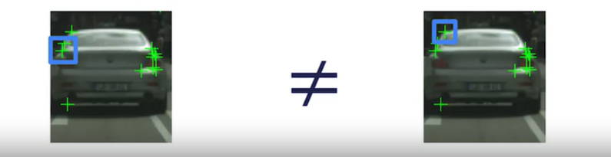
Feature descriptors
2- Distinctiveness: should allow us to distinguish between two close by feature
3- Efficiency: reasonable computation time

Slide 17
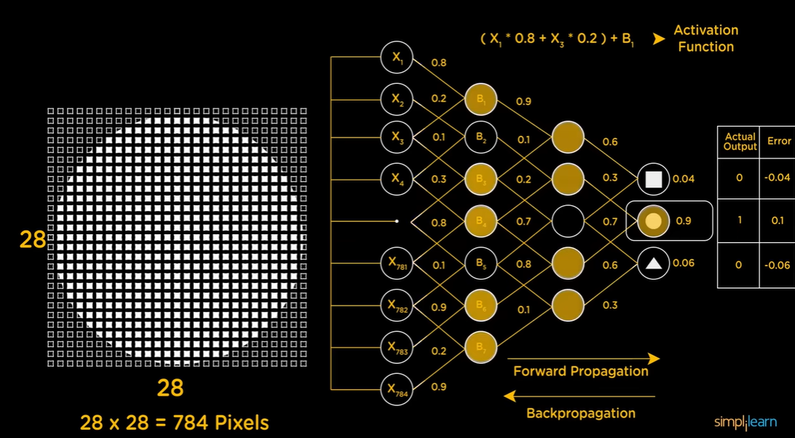
Neural Networks

Slide 18
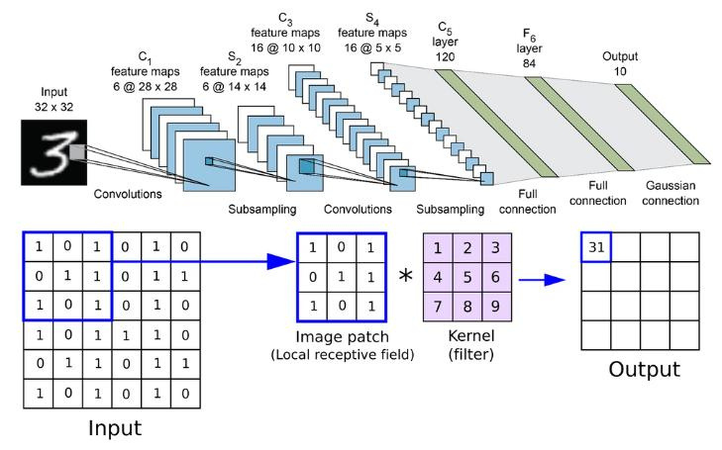
Convolution Neural Networks

Slide 19
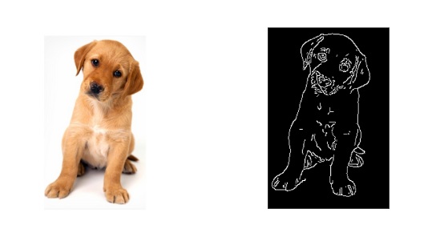
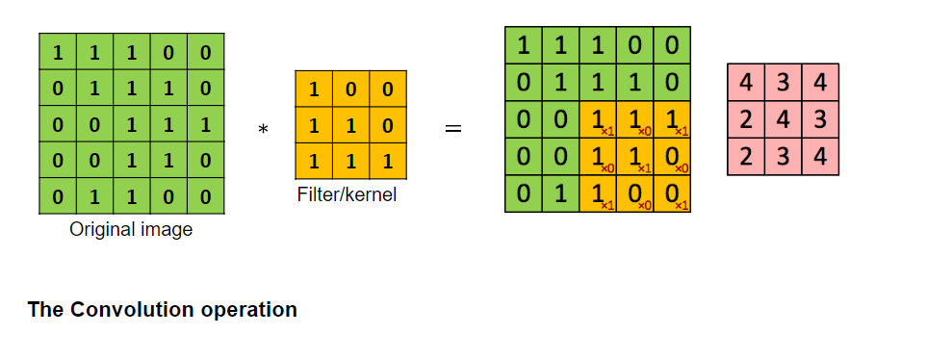
Convolution Neural Networks

Slide 20
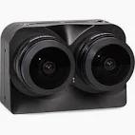
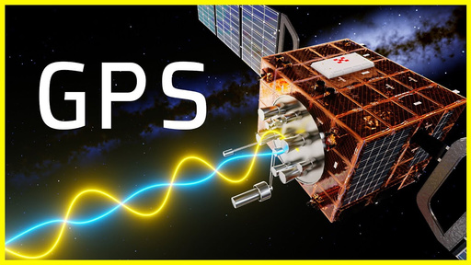
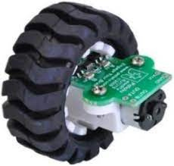
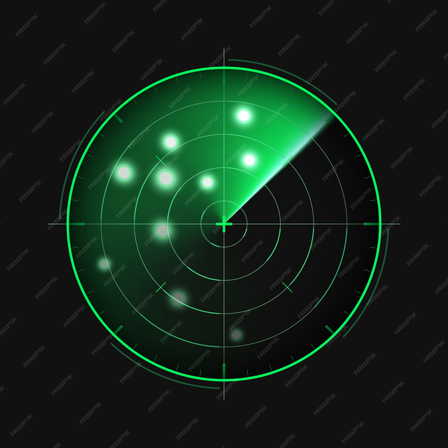
Sensor Fusion
Believe that not a single sensor will enable self driving. the combination of sensors like IMU,GPS , lidar and camera will enable this
Sensor fusion is an essential part that collects data from different sensors to give the driver the ability to understand the environment

Slide 21
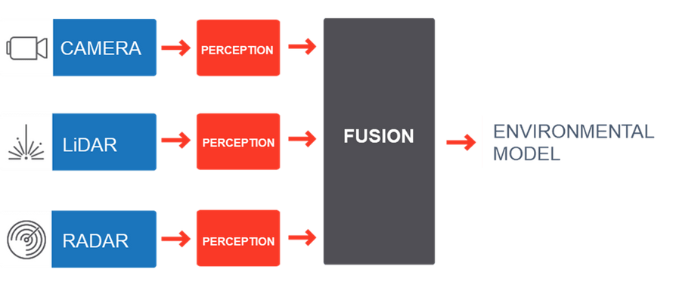
Sensor Fusion
Combines data from 2 or more resources to generate a better understanding of the system
More
consistent
More
accurate
More
dependable

Slide 22




How sensor fusion can help?
Increase quality of data
Reliability
Estimate unmeasured states
Increase coverage area
More
dependable

Slide 23
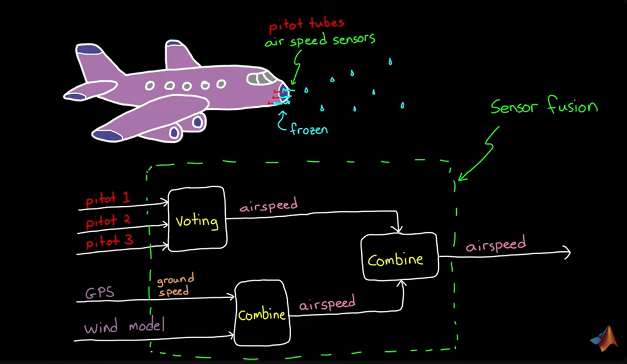
How sensor fusion can help?

Slide 24
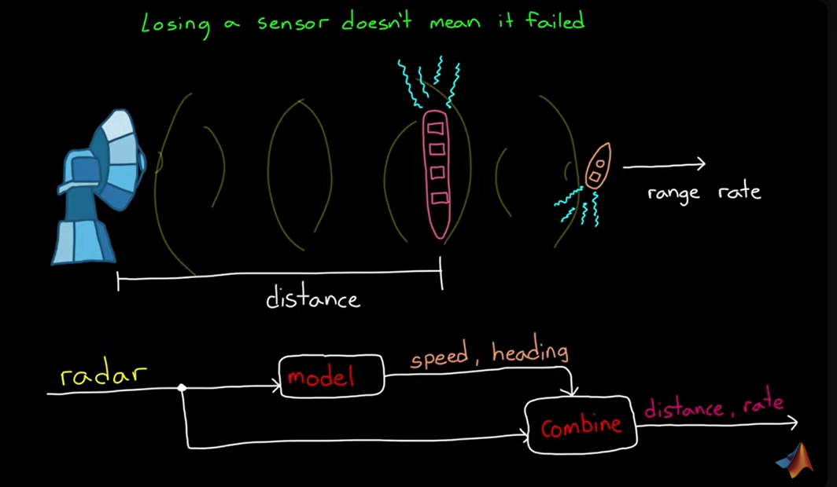
How sensor fusion can help?

Slide 25

Thanks You

